Slide 1
Premier League Player Summary
Kraggle dataset

Slide 2
PL Football Players Dataset
Downloaded from Kraggle dataset.
English Premier League 2021/22 season | Kaggle
Summary contains the list of English Premier league(PL) footballers with their statistics for the 2021/22 season

Slide 3
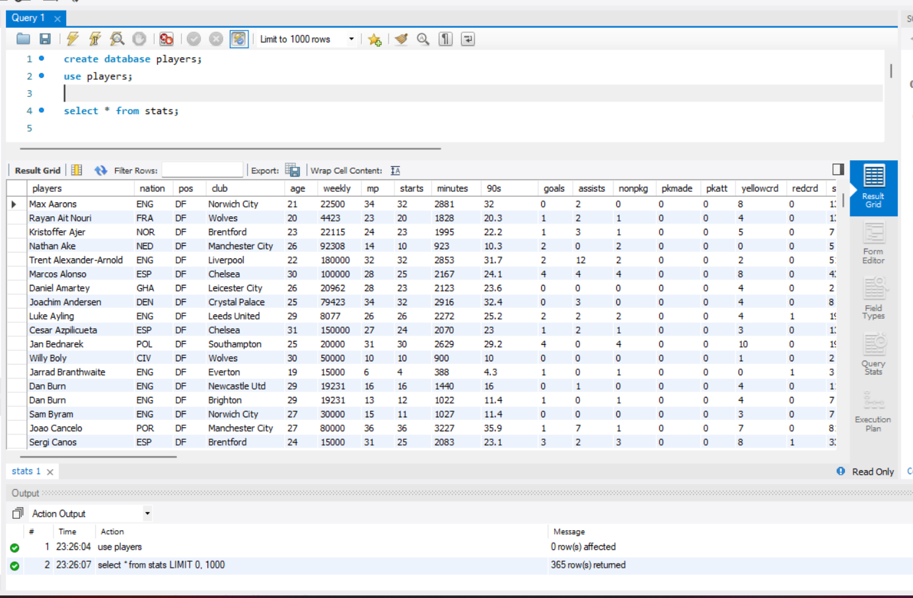
Database creation
create database players;
use players;
select * from stats;
This creates a new database players and lets to use that database

Slide 4
Which team has the youngest squad in PL?
Arsenal | 24.1765
Norwich City | 24.5714
Southampton | 24.5882
Tottenham | 24.6842
Brentford | 24.8667
Aston Villa | 25.3684
Leicester City | 25.4500
Brighton | 25.6316
Leeds United | 25.6471
Everton | 25.7000
Wolves | 25.7647
Crystal Palace | 26.1250
Chelsea | 26.1500
Watford | 26.2941
Manchester City | 26.5556
West Ham | 26.6429
Liverpool | 26.7000
Manchester Utd | 26.7143
Newcastle Utd | 26.8095
Burnley | 28.3529
select club, AVG(age) as Avg_Age from stats group by club order by Avg_Age ASC LIMIT 1 ;
NOTE: Table without the LIMIT 1
Arsenal has the youngest squad with an avg. age of 24.1765.

Slide 5
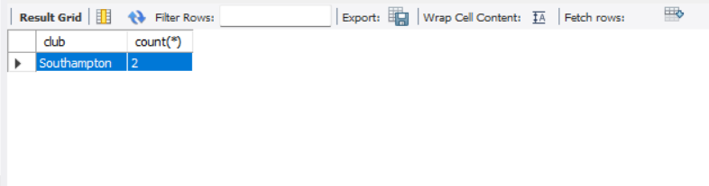
Which Team has more teen players?
select club, count(*) from stats where age<20 group by club order by count(*) desc limit 1 ;
Using the count(*) function to know the number of players.
Shows that Southampton has the highest count of registered first team teenage players

Slide 6
Weekly wages in Descending Order by Clubs
Manchester Utd | 3567500
Chelsea | 2837308
Manchester City | 2628847
Liverpool | 2293500
Tottenham | 1416462
Arsenal | 1369038
Everton | 1225769
Leicester City | 1098654
Aston Villa | 1071924
Newcastle Utd | 1030963
Crystal Palace | 975385
Wolves | 859230
West Ham | 765578
Brighton | 698655
Southampton | 654231
Burnley | 578654
Watford | 490384
Norwich City | 490192
Leeds United | 351537
Brentford | 245962
select club, SUM(weekly) as Weekly_wage from stats group by club order by Weekly_wage desc;
Man United pays the highest weekly wages club-wise in the 2021/22 season.

Slide 7
Top 5 players with most shots on target per game
Harry Kane | 0.5667
Mohamed Salah | 0.5444
Son Heung-min | 0.5222
Cristiano Ronaldo | 0.4333
Sadio Mane | 0.4111
select players, shtont/90 from stats order by shtont/90 desc limit 5;

Slide 8
International players based on nationality (Biggest 5)
select nation, count(*) as No_of_players from stats group by nation order by No_of_players desc LIMIT 5;
ENG | 126
BRA | 20
FRA | 19
POR | 19
ESP | 18
Gives the number of International Players based on nationality in the decreasing order. England has the highest number of players playing in English Premier League, followed by Brazil, France and Portugal.

Slide 9
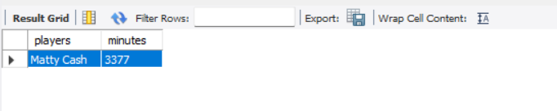
Which player played most minutes?
select players, minutes from stats where minutes = (Select max(minutes) from stats) ;
Select players, minutes from stats order by minutes desc limit 1;
A simple query with the limit fn or make use of the inner query function to find the player who has played the most minutes in the 2021/22 season.

